Slide 1
Speaker Diarization
By
Group No.- 35
Apoorva Iyer- 134
Vinita Khushalani- 135
Deepika Kini- 137
Simran Makhija- 138

Slide 2
What is Speaker Diarization ?
Speaker diarization is the task of determining “who
spoke when?” in an audio or video recording that contains an
unknown amount of speech and also an unknown number of
speakers.
Over recent years, speaker diarization has become an important key technology for many tasks, such as navigation, retrieval, or higher level inference on audio data.

Slide 3
A General Speaker Diarization System
Acoustic beam forming- It deals with the multiple microphones which are often used to record the same meeting from different locations in the room, handling the disturbances from the same (TDOA - BeamformIt toolkit)
Speech activity Detection- Speech Activity Detection (SAD) involves the labeling of speech and non-speech segments. SAD impact on SD performance for 2 reasons. 1.DER= missed speech + FA speech + overlap speaker error
2.It can disturb the acoustic model used in diarization.
Feature Extraction - MFCC(Mel frequency Cepstral Coefficents)
Equal length frames (25ms) and extract coefficents. Short time -stationary else dynamic

Slide 4
Segmentation/Clustering
Core processes.
Segmentation- Aims at splitting the audio stream into speaker homogeneous segments or, alternatively, to detect changes in speakers, also known as speaker turns. Hypothesis testing -
1. H0 both segments come from the same speaker hence a single model
2.H1 there are two different speakers and hence two different models
The criteria for arriving at hypothesis is usually Bayesian Information Criterion (BIC)
Clustering- Can be of 2 types - Bottom-up or Top-Down
Both bottom-up(known as agglomerative hierarchical clustering) and top-down approaches are generally based on hidden Markov models
(HMMs) where each state is a Gaussian mixture model (GMM) and corresponds to a
speaker. Transitions between states correspond to speaker turns.
A Hidden Markov Model (HMM) is a statistical Markov model in which the system being
modeled is assumed to be a process with unobserved (hidden) states. A HMM can
be presented as the simplest dynamic Bayesian network.
Broadcast vs. Conference (Meetings)

Slide 5
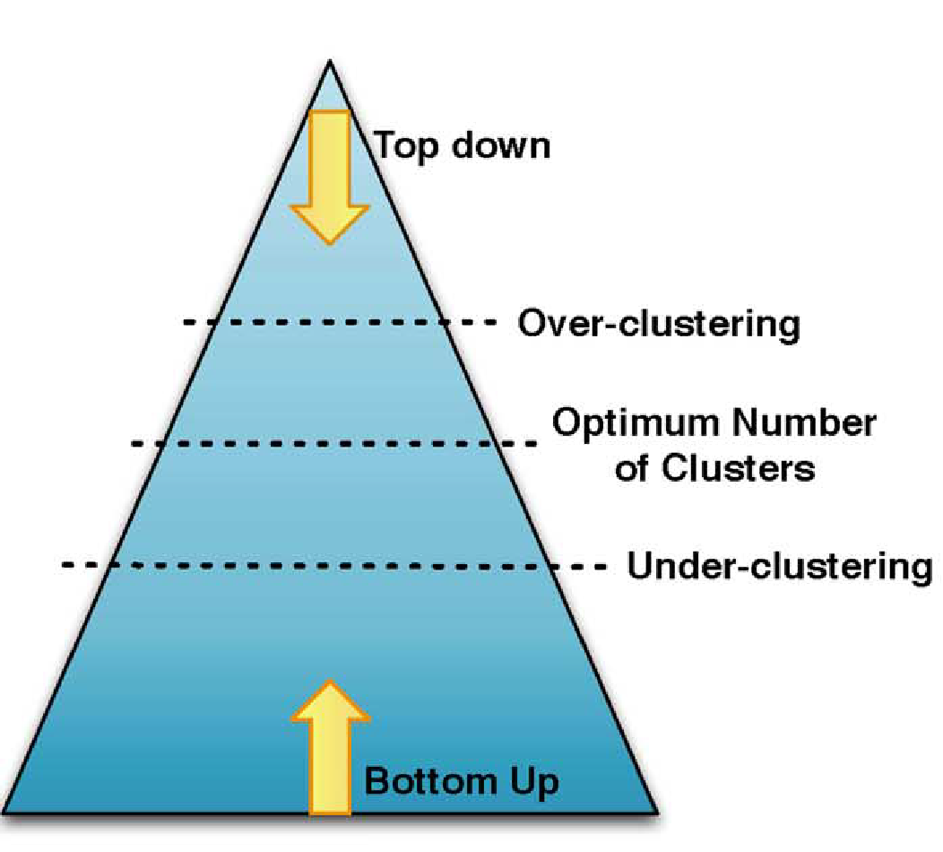
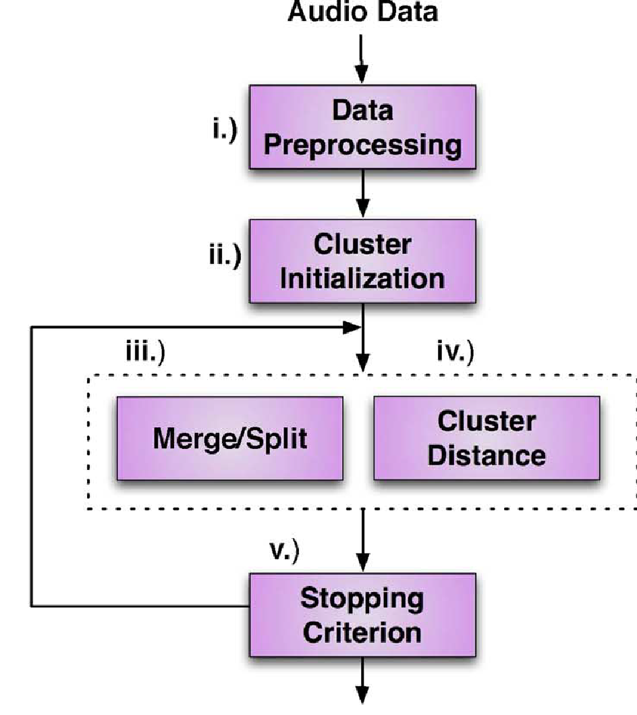
Bottom-up vs. Top-Down

Slide 6
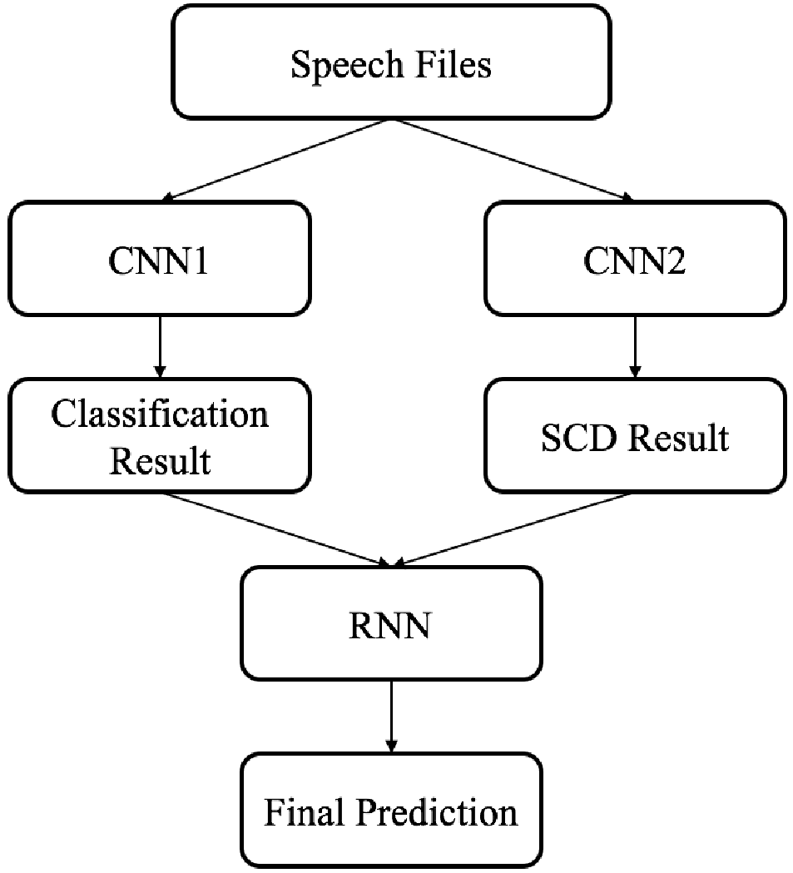
Using Neural Networks
A method to jointly diarize and recognize speakers from a collection of conversations.
Segment the conversation into short segments and recognize the speaker(s) (if any) in each segment independently.
Specifically, we employ one convolutional neural network (CNN) called CNN1, to classify the absolute speaker identity of the set of speakers of interest on equally spaced segments of each conversation.
We then use another CNN, called CNN2, to perform Speaker Change Detection (SCD) on each conversation to model the temporal continuity of speaker identities

Slide 7
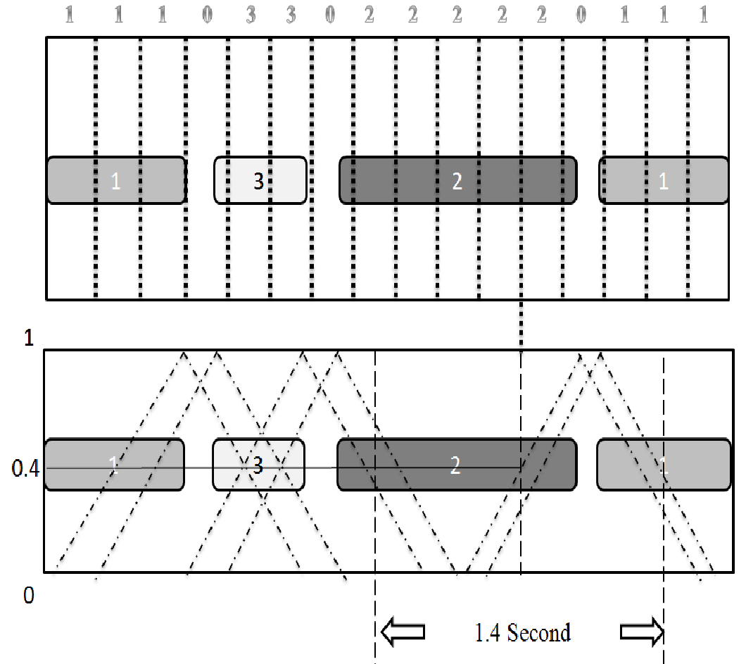
Using Neural Networks
Finally we concatenate the outputs of both CNNs and feed it into a Recurrent Neural Network (RNN) for joint speaker recognition and diarization. Through the RNN, the CNN1 discriminative features and CNN2 temporal continuity information can be integrated together.
As shown in the Figure, each segment corresponds to a label from 0 to N (positive integer), where 0 denotes silence and 1 to N denotes the N possible speakers.

Slide 8
Datasets
CALLHOME American English
2003 NIST Rich Transcription
2000 NIST Speaker Recognition Evaluation
AMI meeting corpus (100 hours, 150 speakers)
ISCI meeting corpus (72 hours, 50 speakers)
YouTube (YT) speakers corpus (550 hours, 998 speakers)
broadcast material from major news stations: CNN, MSNBC,
Fox News, Bloomberg, RT America, BBC

Slide 9
Challenges mostly faced
Number of speakers unknown
Overlap of speech
High variability in noise and background music

Slide 10
Evaluation
As our performance evaluation metric we use Diarization Error
Rate (DER) .This metric takes into account both segmentation
and classification errors, as well as errors from from speech
activity detection stage.
The Diarization Error Rate is computed as:
DER = ESpk + EFA + EMiss

Slide 11
Evaluation
ESpk is speaker error, defined as the time assigned to incorrect speakers divided by total time,
EFA refers to false alarm speech, defined as amount of time incorrectly detected as speech divided by total time
EMiss refers to miss speech defined as the amount of speech time that has not been detected as speech divided by total time.

